Slide 1
Attention Span Detection in Online Education
TEAM TESSERACT

Slide 2
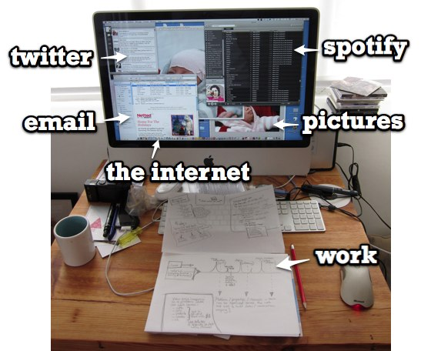
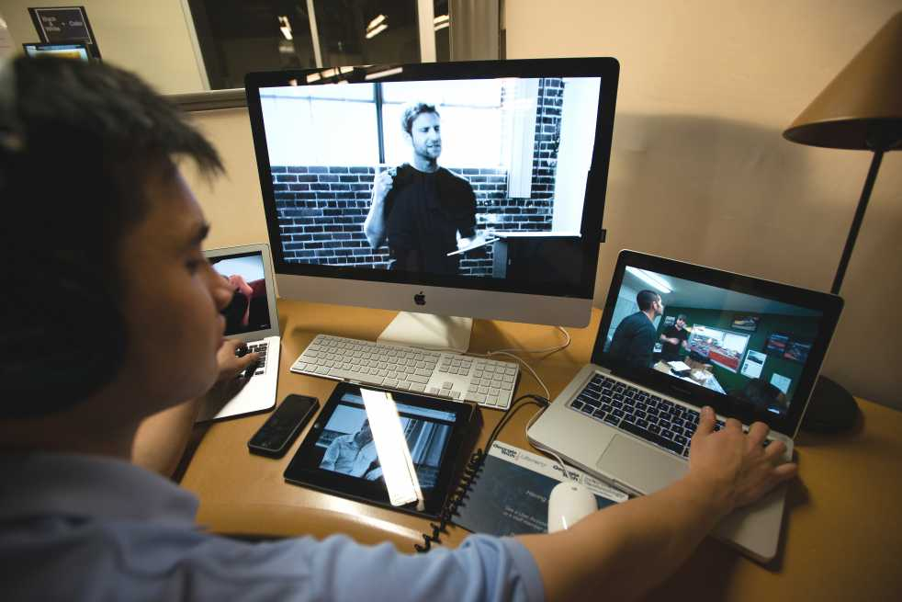

Online education - Distractions
Average Attention span in 1988 – 12 minutes
Average Attention span in 2018 – 5 minutes

Slide 3

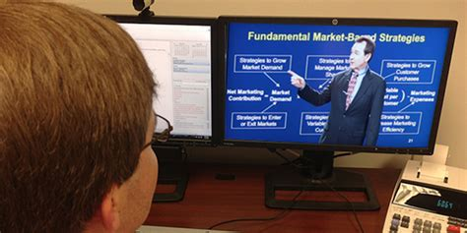
Problem statement
To create a mechanism for monitoring and measuring the Attention span of a student in real time.

Slide 4
Way of Approach
Blink Rate Detection
Position Change (Restlessness)
Background Noise Detection
Eye Position Tracking
Emotion Classification
Facial Recognition

Slide 5
Way of Approach
Integration of all modules – Multi-threading
Graph plotting
Pop up quiz at regular intervals with Voice over module for visually impaired people.
Generating Average Attention span – Formula
Sending reports to user via email

Slide 6
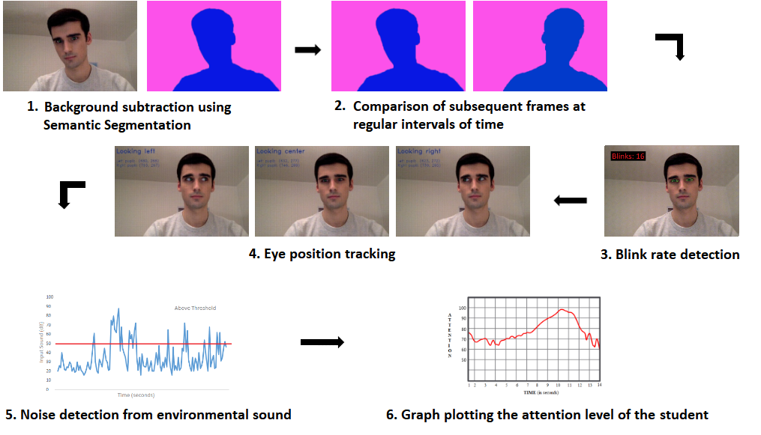
Solution steps

Slide 7



Position change
Frame at T seconds
Frame at (T+5) seconds
Background subtraction using Semantic segmentation

Slide 8
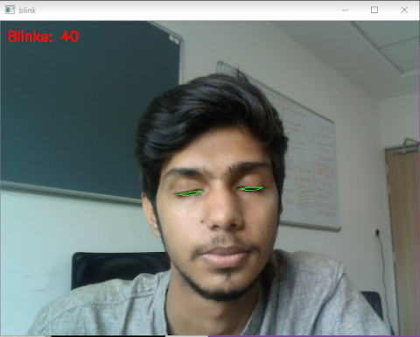
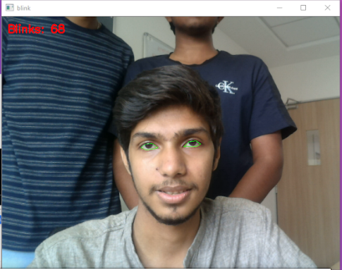

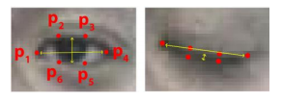
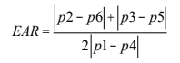
Blink rate detection
Haar Cascade classifier

Slide 9
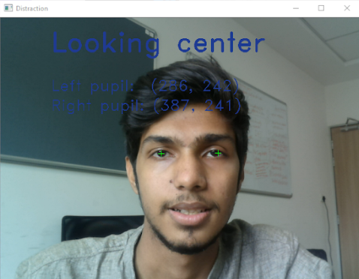
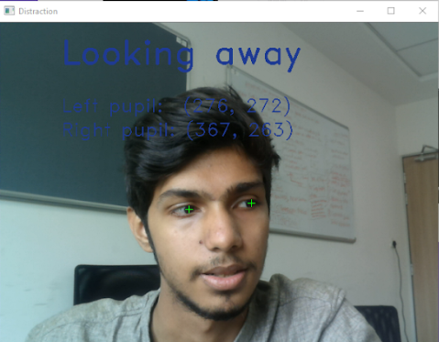
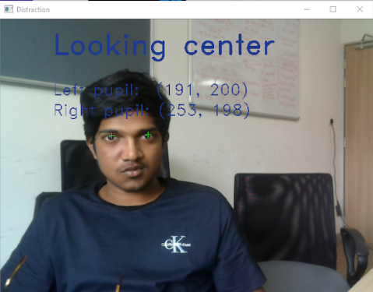
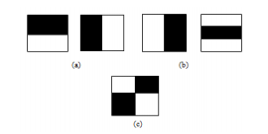
Eye Position Tracking
Haar Cascade classifier

Slide 10
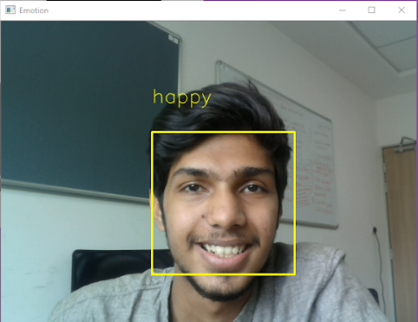
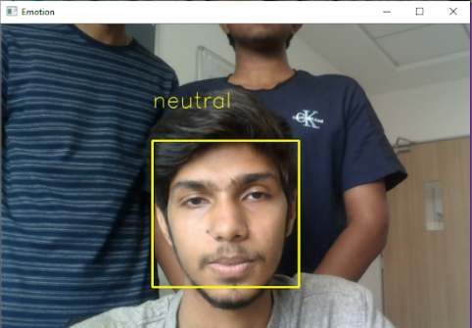
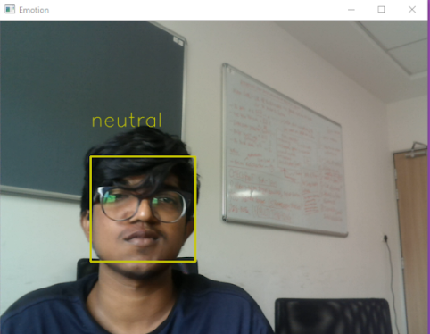
Emotion Classification

Slide 11
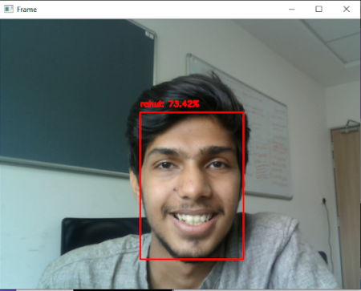
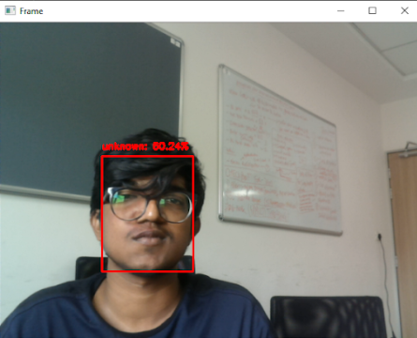
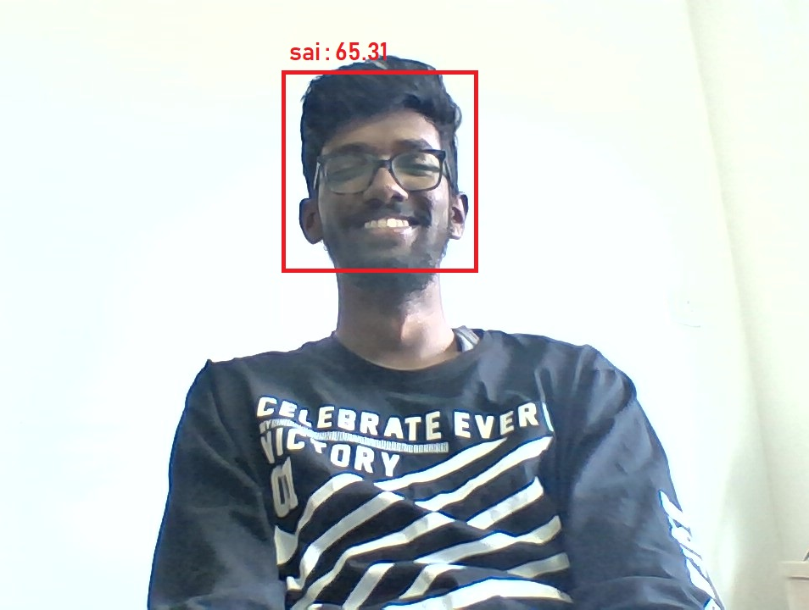
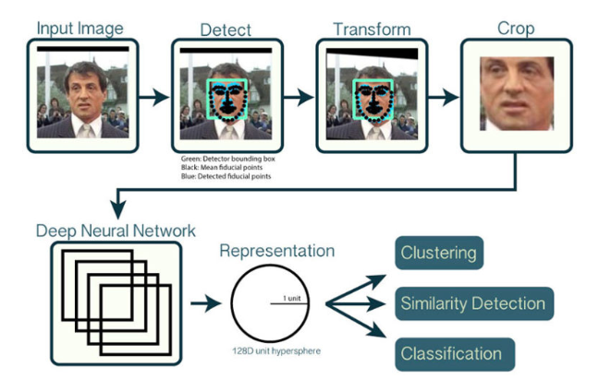
Facial Recognition
Deep learning
Neural Networks

Slide 12
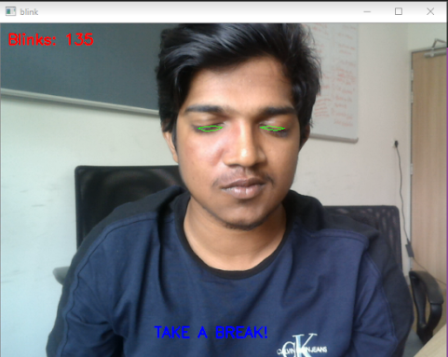
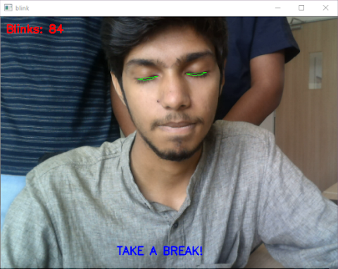

Drowsiness detection

Slide 13
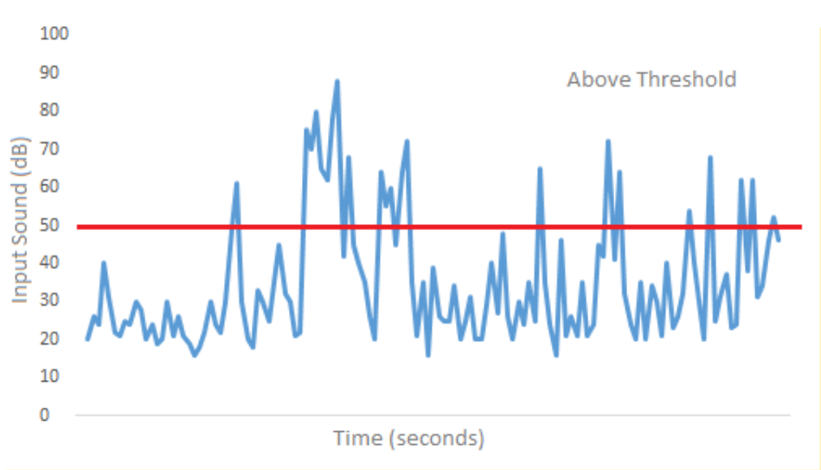
Noise level detection

Slide 14

Website (Login Page)

Slide 15
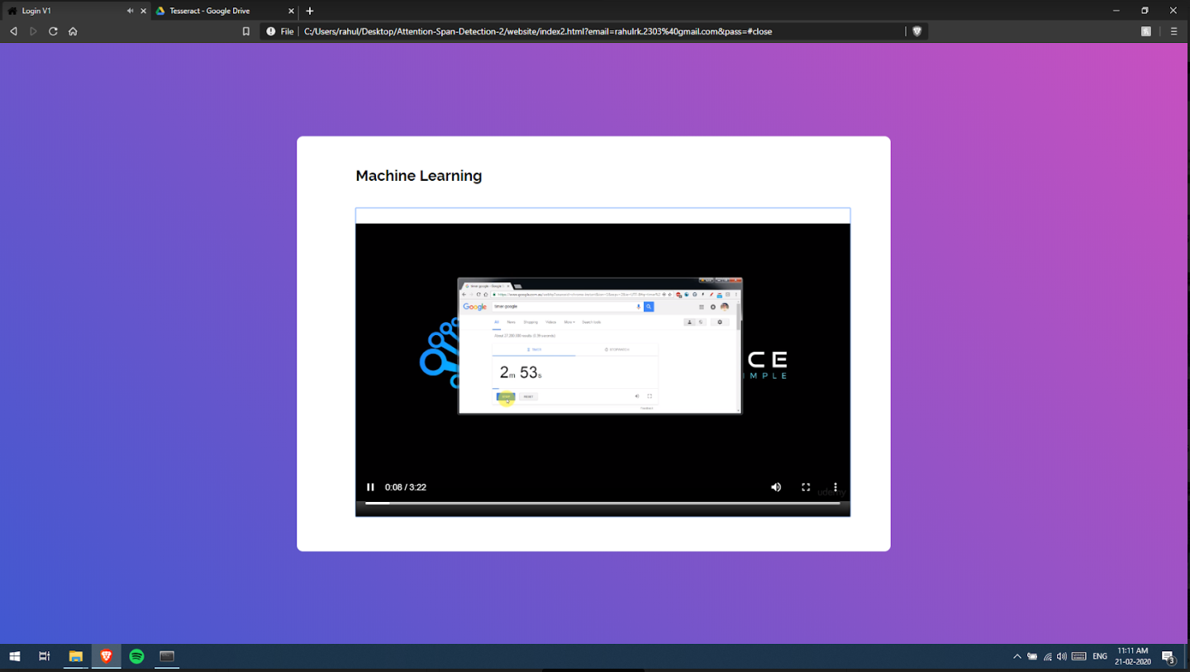
Outputs

Slide 16
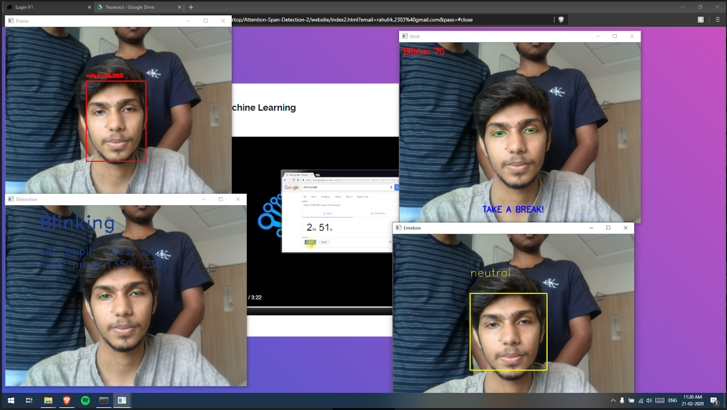
Outputs

Slide 17

Pop up quiz at regular intervals with Voice over module for visually impaired people

Slide 18

Storing parameter data

Slide 19
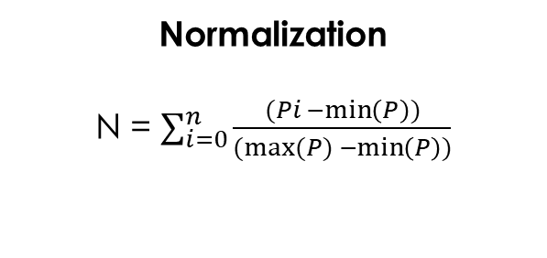
Average Attention level
α – Blink Rate
β – Eye position tracking (Distraction)
€ - Body posture
Ω - Noise level
 - Facial expression
 - Average attention span
 = [(α*0.4) + (β*0.5) + (€*0.3) + (Ω*0.2) + (*0.1)] /1.5
Normalization
N = $\sum_{i=0}^{n}{\frac{(Pi −\min\left(P\right))}{(max⁡(P) −\min\left(P\right))}}$

Slide 20
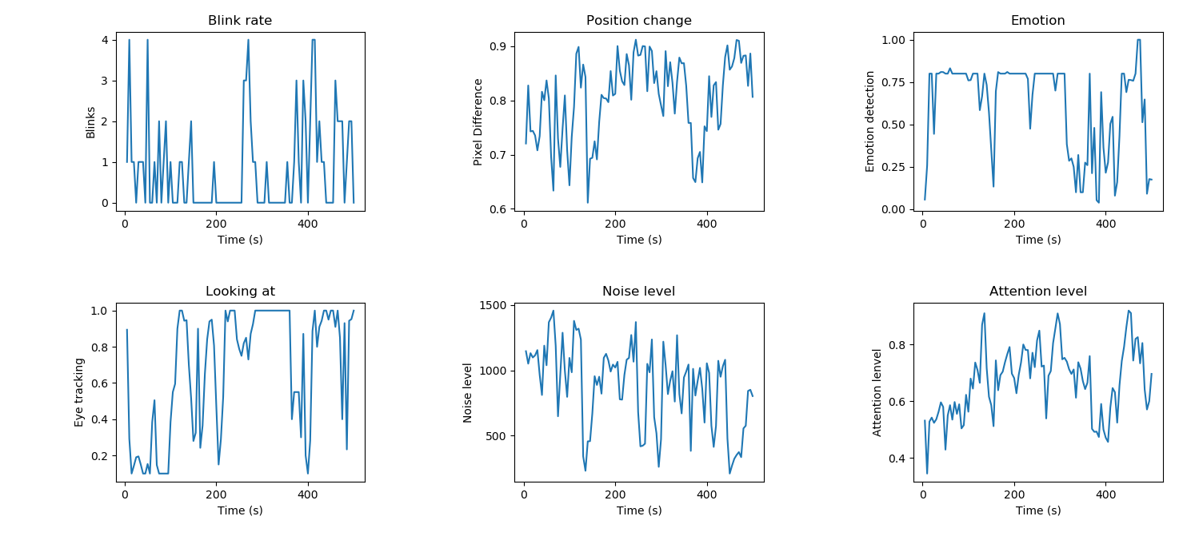
Graph Plotting
Average attention span is : 78.62 %

Slide 21
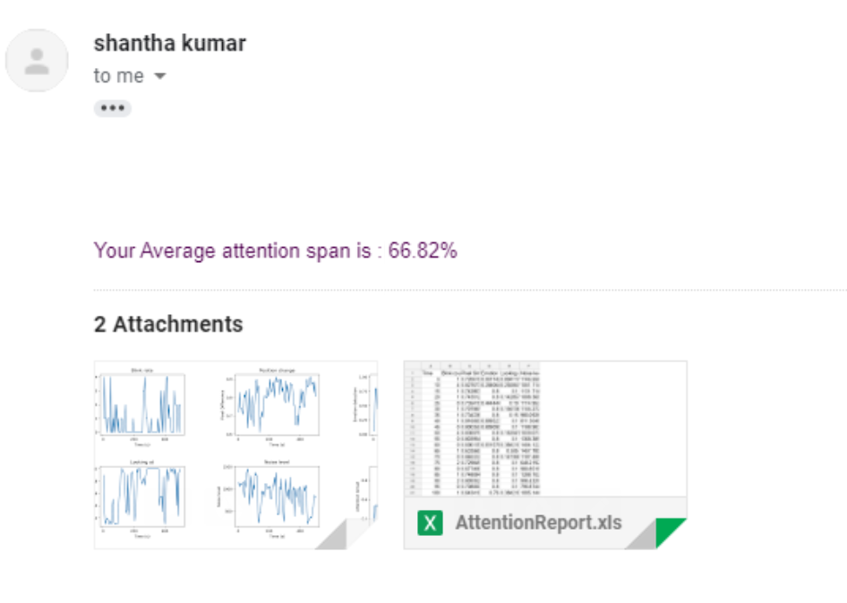
Mail sent to the student

Slide 22


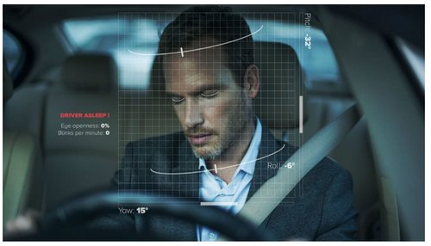
Application in current world and future
Online Education
Digital Advertising
Driver drowsiness detection

Slide 23
Scale of impact
Attention span detection in online education system is the need of the hour.
Revolutionary change in the education sector.
Helps to improve the overall knowledge gain of students.
Helps improve quality of education.
Digital advertising prediction.
Helps to avoid accidents due to drowsiness of drivers.

Slide 24
Feasibility
High performance.
Less resource intensive.
Multithreading concept
Completely image processing solution.
Does not need any external hardware components.

Slide 25
Novelty of solution
One-of-a-kind algorithm.
No existing solution.
High accuracy.

Slide 26
Cost Effectiveness
No external hardware.
Productive result with available resource.
Only software image processing.
Completely open-source algorithms.

Slide 27
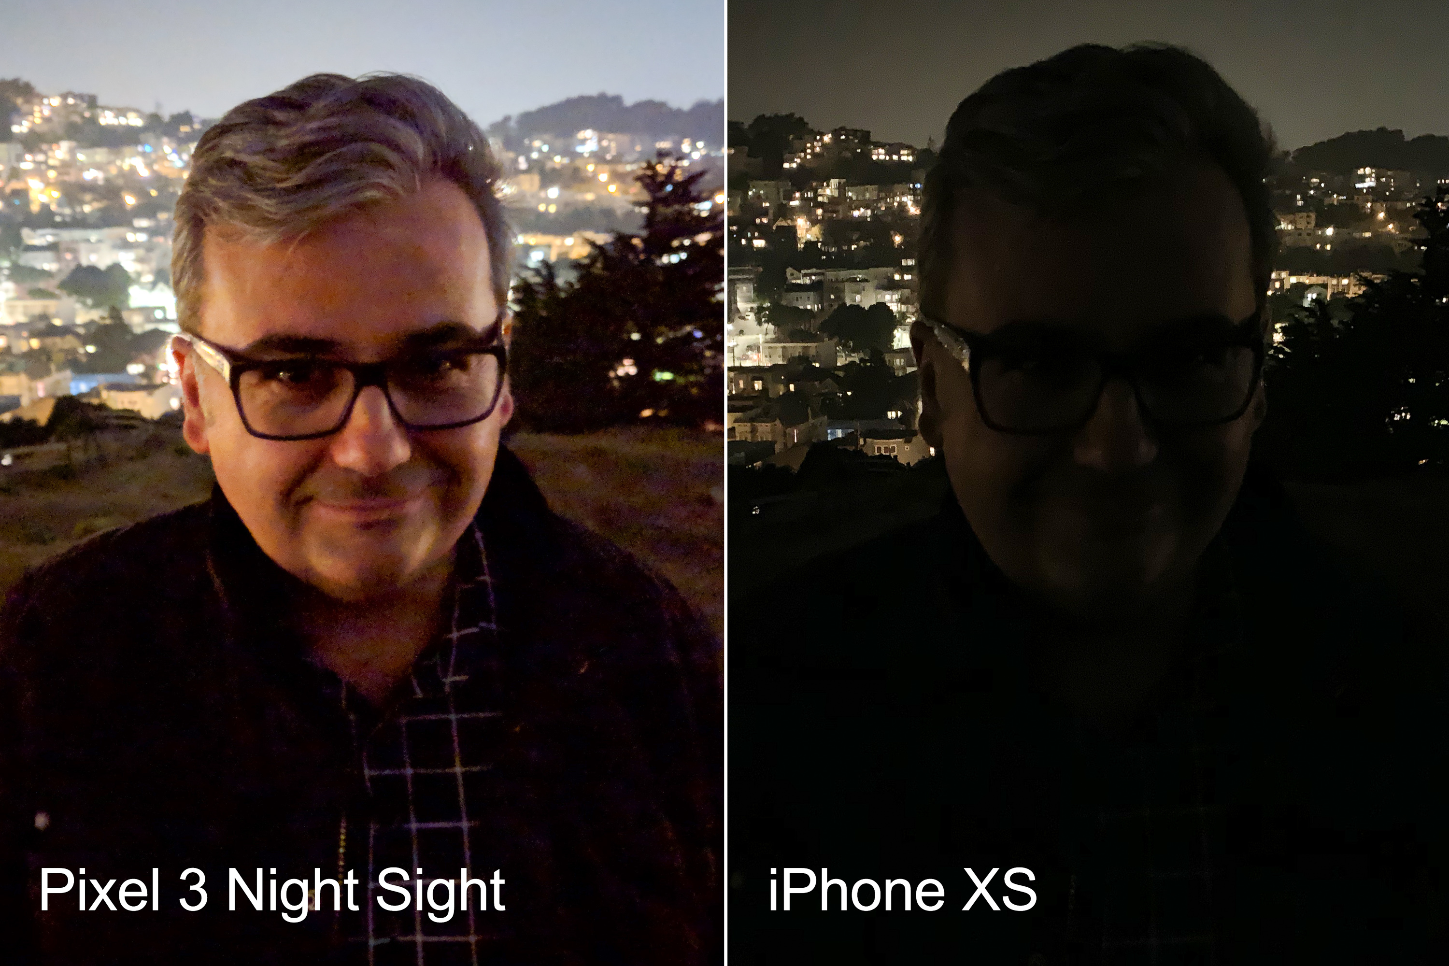
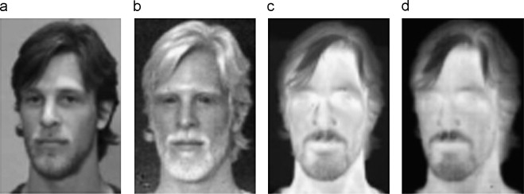
Potential for future enhancements
Google Night Vision for detecting faces in dark environment.
Infrared Sensors

Slide 28
Sustainability, Social Impact & Conclusion
Improves over all quality of Education
Induces a sense of responsibility in the students undertaking online courses
Overall boost in attention level of students
Gives an instantaneous detailed report to both students and lecturers
Has a positive impact in today’s youth

